Slide 1
A Visual Analytics Process for Exploring Risk and Vulnerability in International Food Trade Networks
Travis Seville
Committee: Ross Maciejewski (Chair),
I-Han Hsiao, Shade Shutters

Slide 2
Outline
Define the problem
Developed a visual analytics system for exploring second-order effects of climate change under the lens of global trade
Current visualizations
Case studies demonstrating the use of the system
Notes:
First we’ll define the problem,
Offer our solution
Quick comparison to some current systems
And execute 2 case studies showing the potential of the system
#

Slide 3
What Problem?
Increase in globalization leads to an increase in utilization of the food trade network to feed people, countries are becoming more import-dependent
Climate events are no longer localized and these regional events may have global effects on food security^{[1]}
There is limited research considering second-order effects of climate events to the food trade network
[1] Sternberg, T., “Chinese drought, bread and the Arab Spring”, Applied Geography 34, 519–524 (2012).
Notes:
What problem are we trying to solve?
By definition, more globalization leads to more trade to feed people and import-dependency is a result
Another of way of saying that is how do we analyze the impact cause by a climate event to the food trade network

Slide 4


What are n^{th}-Order Effects?
We have three countries: A, B and C
Country A produces some food
Country A exports to Country B
Trade link X
Country B exports to Country C
Trade link Y
A
B
C
X
Y
Notes:
Basically, what is an n-th order effect?
As background say we have this situation
#
Country A produces some kind of good
#
They trade some of their production to B
#
Country B also trades the same good, note, they may produce it as well

Slide 5
Zero-Order Effect
What happens when a climate event impacts Country A?
Country A produces less food, but neither of the trade links are affected
Drought
A
B
C
X
Y

Slide 6
First-Order Effect
What happens when a climate event impacts Country A?
Country A produces less food, but only trade link X is affected
Drought
A
B
C
X
Y
Notes:
Again we have a drought
It causes Country A to produce less food
But now Country A reduces its exports in order to recoup some of its lost production

Slide 7
Second-Order Effect
What happens when a climate event impacts Country A?
Country A produces less food and both trade link X and Y are both affected
This could propagate even further along the network causing third, fourth, et cetera level effects
Drought
A
B
C
X
Y
Notes:
Again we have a drought
It causes Country A to produce less food
Again Country A reduces its exports in order to recoup some of its lost production
But now Country B reduces its own exports to mitigate its loss of imports!!!
My system models these effects

Slide 8
Why Is This a Problem Now?
Climate change is causing more intense climate events^{[1]}
An increase in globalization results in an increase in dependency on the food trade network
Climate events are becoming increasingly more devastating to the food trade network and food security
Current research and tools are limited
[1] Webster, P. J., G. J. Holland, J. A. Curry and H.-R. Chang, “Changes in tropical cyclone number, duration, and intensity in a warming environment”, Science 309, 5742, 1844–1846 (2005).
Notes:
According to research, intensity of climate events has increased
#
Coupled with an increase in globalization and dependency
#
The result is more devastation is occurring and negatively impacting food security
#

Slide 9
Outline
Define the problem
Developed a visual analytics system for exploring second-order effects of climate change under the lens of global trade
Current visualizations
Case studies demonstrating the use of the system
Notes:
A goal of this system is to help direct international aid
In the previous slides we posited that Country A was affected by a climate event
Sure, We can help the affected country A
But We may need to shift some of that aid to counties downstream based on global trade to …. say country B, C or even further
We’ll move on to how Idid that

Slide 10
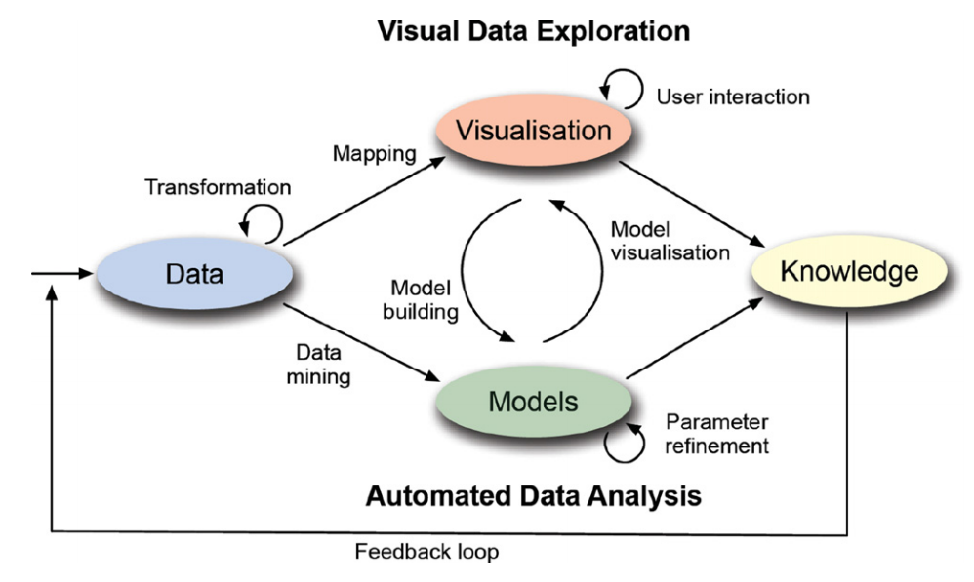
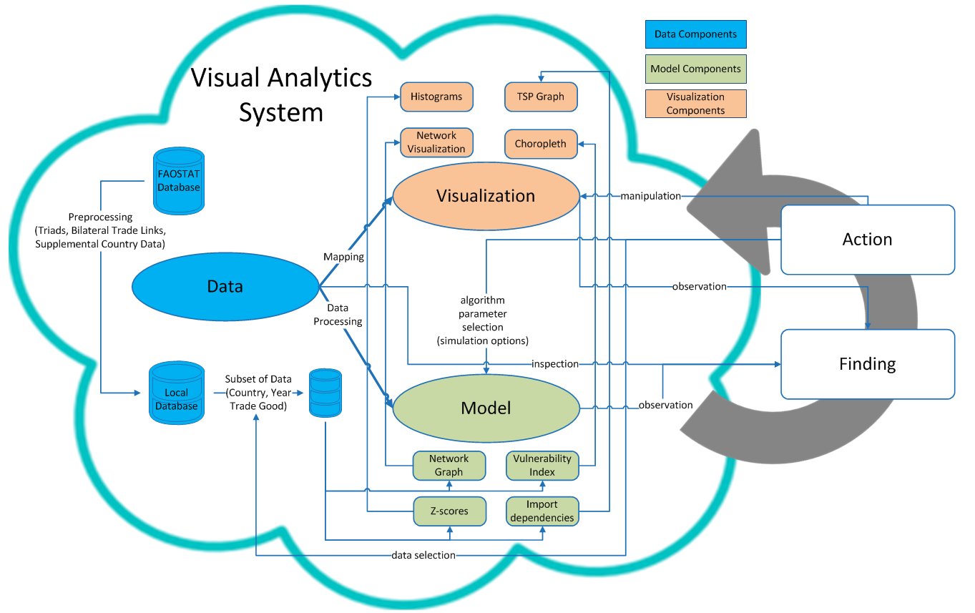
Visual Analytics
Typical Visual Analytics System
Keim et al. (2011)
My Visual Analytics System
motivated by Sacha et al. (2014)
Keim, D., J. Kohlhammer, M. Pohl, G. Santucci and G. Andrienko, “Solving problems with visual analytics”, Procedia Computer Science 7, 117–120 (2011).
Sacha, D., A. Stoffel, F. Stoffel, B. C. Kwon, G. Ellis and D. A. Keim, “Knowledge generation model for visual analytics”, IEEE transactions on visualization and computer graphics 20, 12, 1604–1613 (2014).
Notes:
4 main parts
Data, model, viz
Feedback loop is represented in the action and finding blocks

Slide 11
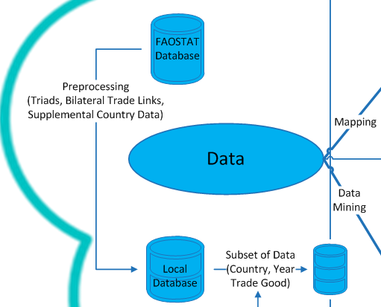
Visual Analytics
Data
Food and Agriculture Organization Corporate Statistical Database (FAOSTAT DB)
Snapshot of trade link data from 1986-2013
Trade link
Year
Crop (e.g. wheat)
Exporting country
Importing country
Dollar value
Notes:
Data!
What attributes are present in the database
Years, the crops
Import value,

Slide 12
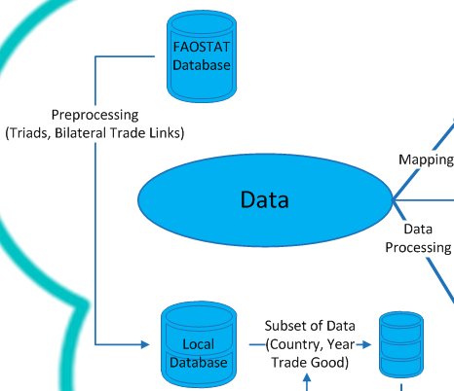
Visual Analytics
Data
Preprocessing
Triad calculation
Bilateral trade links
Selection
Interactions allow filtering of data
What year
What crop
What country
Notes:
Try ad

Slide 13
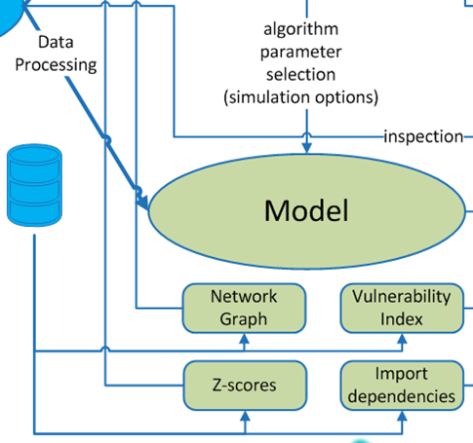
Visual Analytics
Model
Simulated Climate Event
Vulnerability Index
Import Dependency
Z-Score
Network Graph
Notes:
A couple of things I model for this framework
Cascading impact formula
What is dependency and how related to risk/vulnerability
Define vulner, show map, simulate drought in Thailand, what is the risk
Data assumption formula
Truncated case study

Slide 14
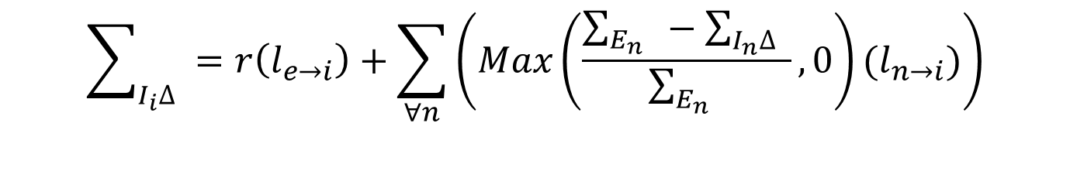
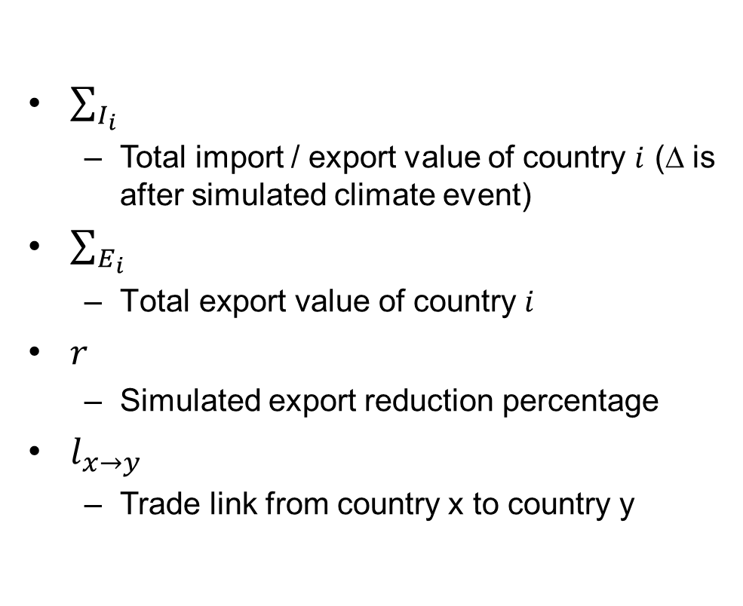
Visual Analytics
$$\sum_{I_{i}∆}{ }=r\left(l_{e→i}\right)+\sum_{∀n}^{ }{\left(Max\left(\frac{\sum_{E_{n}}{ }−\sum_{I_{n}∆}{ }}{\sum_{E_{n}}{ }},0\right)(l_{n→i})\right)}$$
Model
$\sum_{I_{i}}{ }$
Total import / export value of country $i$ (∆ is after simulated climate event)
$\sum_{E_{i}}{ }$
$\text{Total} \text{export} \text{value} \text{of} \text{country}$ $i$
$r$
Simulated export reduction percentage
$l_{x→y}$
Trade link from country x to country y
Simulated Climate Event
Vulnerability Index
Import Dependency
Z-Score
Network Graph
Notes:
This indicates that the direct link is reduced, then all the other links only contribute a percentage of the remainder.
If
$r\left(l_{e→i}\right)$ direct link
$Max\left(\frac{\sum_{E_{n}}{ }−\sum_{I_{n}∆}{ }}{\sum_{E_{n}}{ }},0\right)$ indicates a country will reduces its exports and by whatever is remaining hand it out in same distribution as before; this is the new ratio of trade links from country n
Because if $\sum_{I_{n}∆}{ }$> $\sum_{E_{n}}{ }$then it is 0 times old trade link
$(l_{n→i})$ is the previous link
LIMITATION: This may not be accurate, due to for example political implications (a country is required to export X to based on trade agreements)

Slide 15
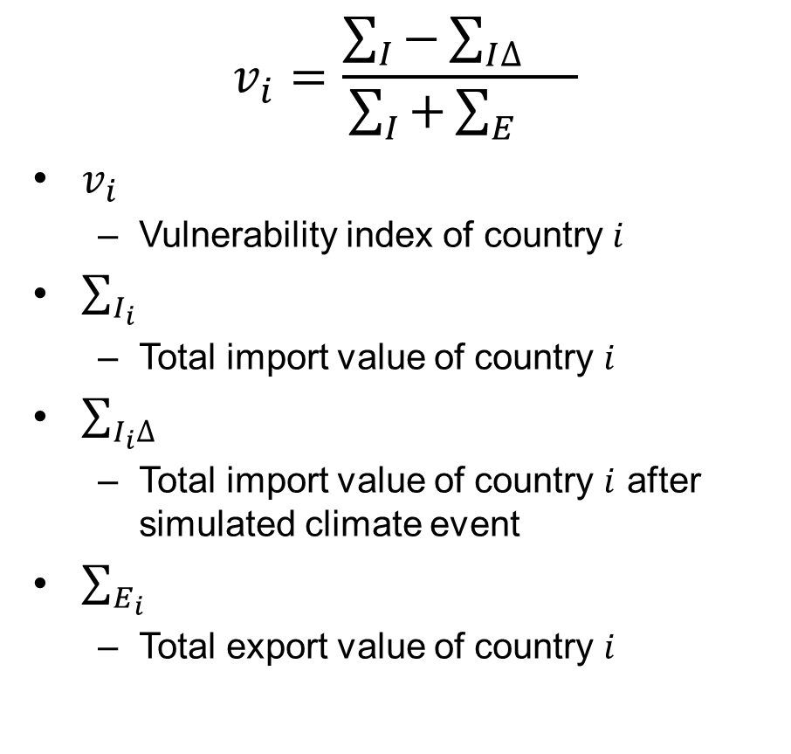
Visual Analytics
$$v_{i}=\frac{\sum_{I}{−\sum_{I∆}{}}}{\sum_{I}{+\sum_{E}{}}}$$
$v_{i}$
Vulnerability index of country $i$
$\sum_{I_{i}}{ }$
Total import value of country $i$
$\sum_{I_{i}∆}{ }$
Total import value of country $i$ after simulated climate event
$\sum_{E_{i}}{ }$
Total export value of country $i$
Model
Simulated Climate Event
Vulnerability Index
Import Dependency
Z-Score
Network Graph
Notes:
How we color the choropleth map we’ll see shortly
Basically a function of lost imports and total trade that country participates in for that good.

Slide 16
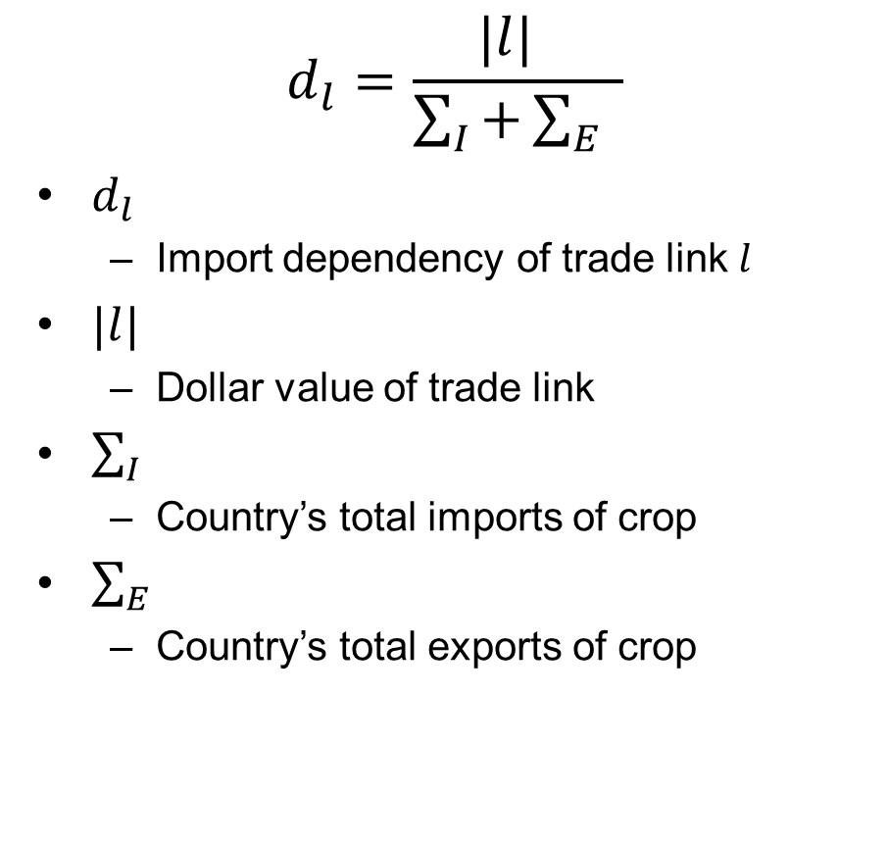
Visual Analytics
$$d_{l}=\frac{|l| }{\sum_{I}{+\sum_{E}{ }}}$$
$d_{l}$
Import dependency of trade link $l$
$|l|$
Dollar value of trade link
$\sum_{I}{ }$
Country’s total imports of crop
$\sum_{E}{ }$
Country’s total exports of crop
Model
Simulated Climate Event
Vulnerability Index
Import Dependency
Z-Score
Network Graph
Notes:
This is basically the individual trade links potential for contribution to the vulnerability index

Slide 17
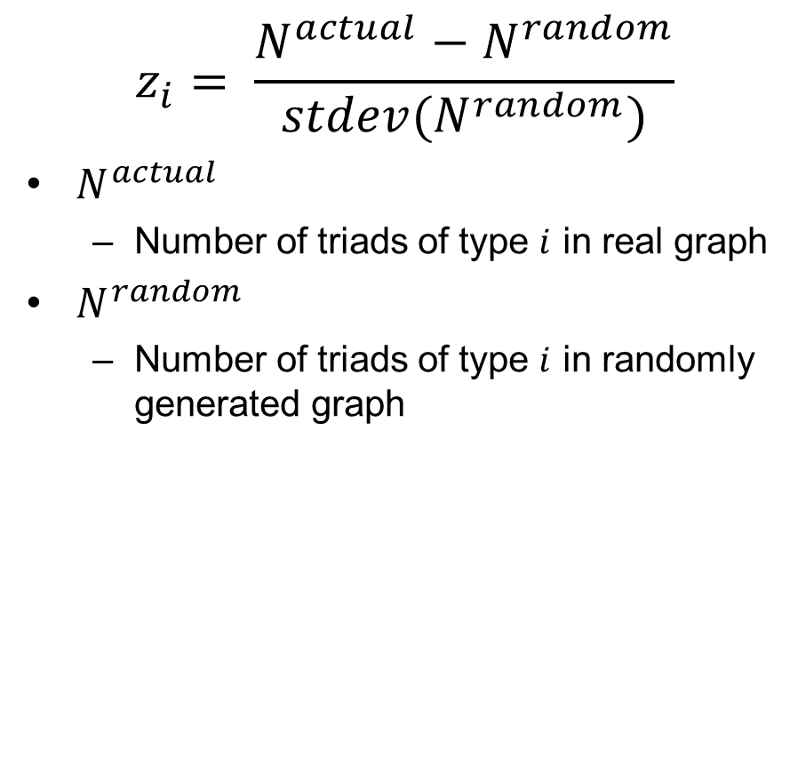
Visual Analytics
$$z_{i}= \frac{N^{actual}−N^{random}}{stdev(N^{random})}$$
$N^{actual}$
Number of triads of type $i$ in real graph
$N^{random}$
Number of triads of type $i$ in randomly generated graph
Model
Simulated Climate Event
Vulnerability Index
Import Dependency
Z-Score
Network Graph
Notes:
Triad significance profiles we model the z-score against the number of a particular type of triads in a random graph

Slide 18
Visual Analytics
Model
IFTN as weighted directed graph
Nodes are counties
Edges are trade links
Direction indicates the direction of trade (from exporter to importer)
Weighted by import dependency
High dependency on imports indicates a higher risk^{[1]}
Simulated Climate Event
Vulnerability Index
Import Dependency
Z-Score
Network Graph
[1] d’Amour, C. B., L. Wenz, M. Kalkuhl, J. C. Steckel and F. Creutzig, “Teleconnected food supply shocks”, Environmental Research Letters 11, 3, 035007 (2016).

Slide 19
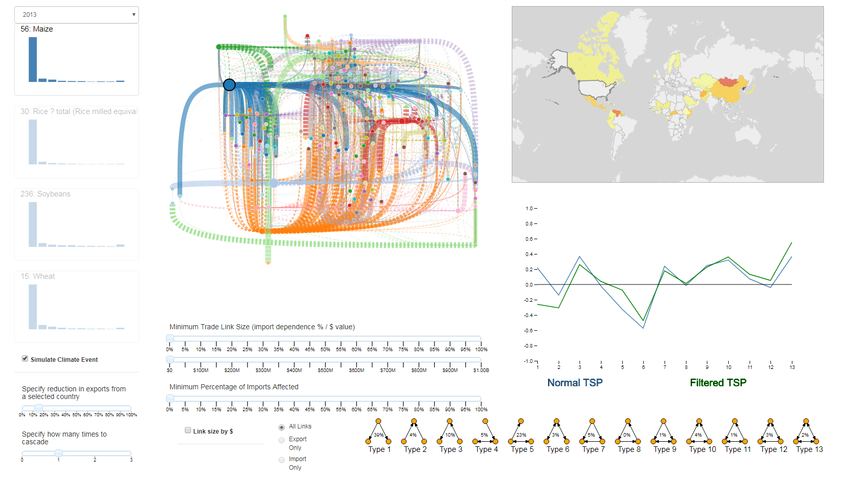
Visual Analytics System Dashboard
Notes:
This is an overview of the visualization part of the system
Left histograms and simulation engine options where we configure simulation
Middle network graph and filtering options
Right the choropleth map and tsp graph / distributions
In this instance we have simulated a 15% corn reduction from the united states and are visualizing the impact to the trade network
We know US is a large exporter, and potentially large number of cascading effects due to the sheer number of trading partners
We haven’t applied any filtering here we will later and really see how it focuses the network graph

Slide 20
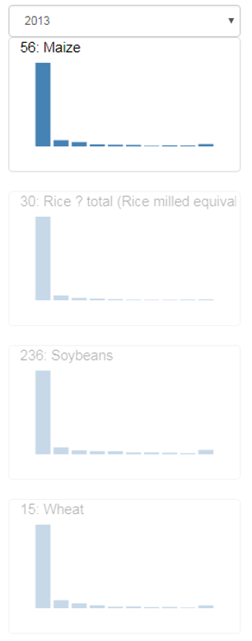
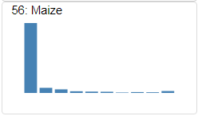
Histograms
Description
Histogram for corn 2013
Distribution of trade links based on import dependency
Links in the left-most bins indicate more diversified imports
Links in right-most bin indicate import portfolios that are made up of fewer trade links
The opaque indicates the currently selected crop
Clicking another histogram changes the context
Notes:
Distribution of trade links based on import dependency,
Links in the left-most bins indicate more diversified imports
Links in right-most bin indicate import portfolios that are made up of fewer trade links
Each bin is 10% range, far right is import dependencies of 90-100%
#
The opaque indicates the currently selected crop
Clicking another histogram changes the context

Slide 21
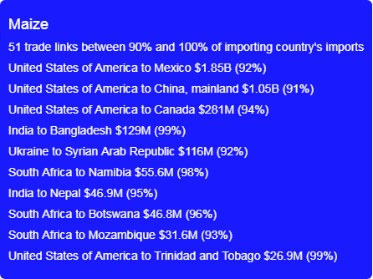
Histograms
GUI & Interactions
Tooltip of far right histogram bin
Tooltip shows the United States to Mexico corn trade link in 2013
$1.85 billion
92% of Mexico’s total imports of corn
High import ratio
If exports are also low this means a high import dependency
Notes:
We can hover over any pertinent part of the system and produce a tooltip
Here we are over a bin in the histograms sections and the tooltip highlights some links of interest

Slide 22
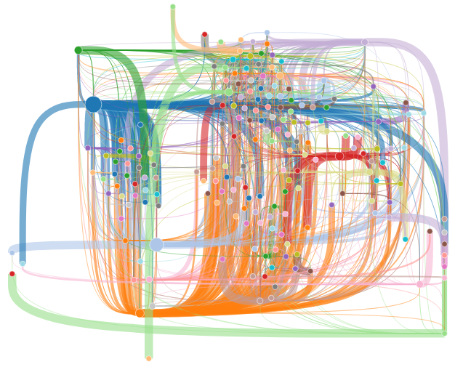
Network Graph
Description
Network graph for corn in 2013
Shows the entire trade network for the selected crop
Nodes are approximately geographically positioned
Labels added here for clarity
Thicker lines indicate a higher import dependency of that trade link
Color indicates direction
Links take the color of the exporter
US
Japan
Notes:
#
#
#
Blue US, Orange Argentina, Russia pink

Slide 23
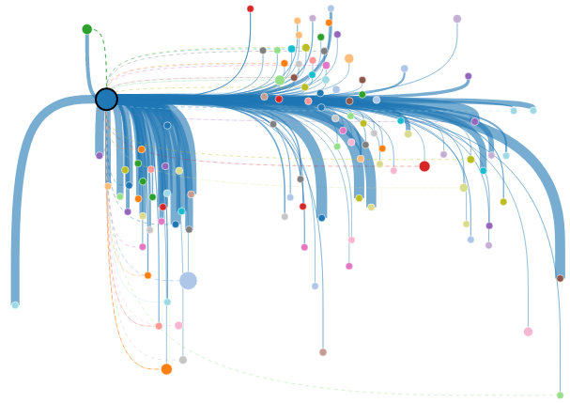
Network Graph
GUI & Interactions
Weighted by import dependency
Selecting a node filters the data to only show imports and exports associated with that country
Dashed lines indicate imports to selected country
These links looks fairly important
China
Japan
US
Mexico
French
Polynesia

Slide 24
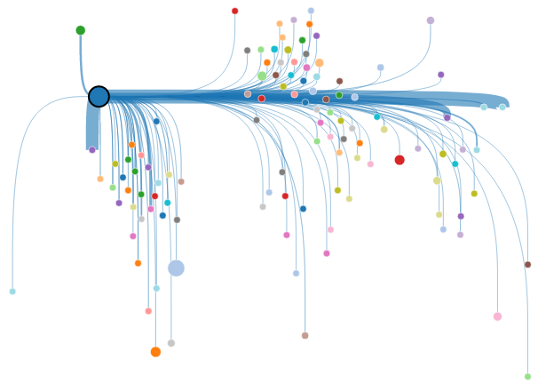
Network Graph
GUI & Interactions
Weighted by link dollar value
Using the dollar value as the weight gives context
We see Mexico again as in the histogram
Verification of import dependency
China
US
Japan
Mexico
French
Polynesia
Notes:
Change the weighting to be by dollar value

Slide 25
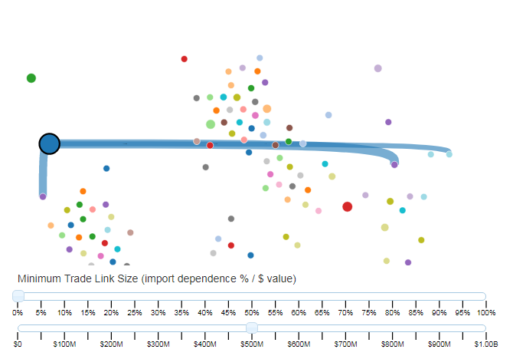
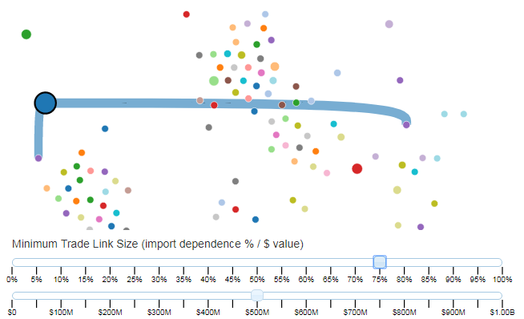
Network Graph
GUI & Interactions
Weighted by import dependency
Or we could have just filtered
Filtered by trade links of ≥ $500 million in value
Filtered by import dependence ≥ 75%
In this way we are able to look for import dependent links of high value
China
US
Japan
Mexico
Notes:
#2
So trade link to japan goes away because although it is a large dollar value trade link, it has a diverse enough profile that there is less risk if it were to be lost

Slide 26
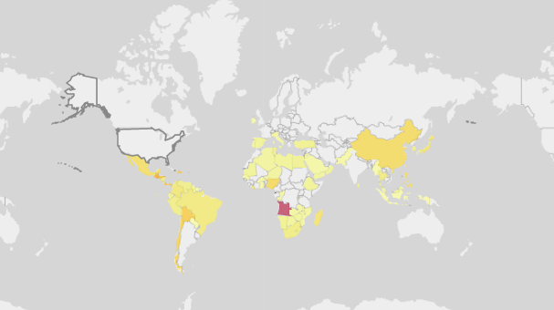
Choropleth Map
Description
Choropleth of 15% wheat reduction from the United States
Displays vulnerability indices based on simulation results
Darker red indicates a high vulnerability index
Notes:
For instance, in this choropleth Angola in south Africa is impacted

Slide 27
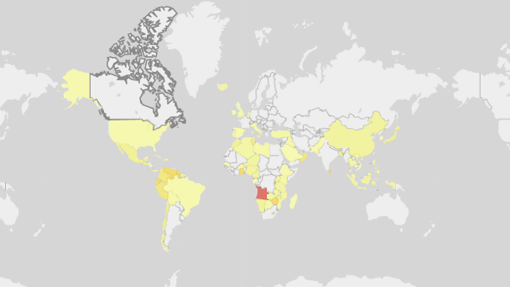
Choropleth Map
GUI & Interactions
Choropleth of 15% wheat reduction from Canada
Clicking a country here also selects it for the simulation

Slide 28
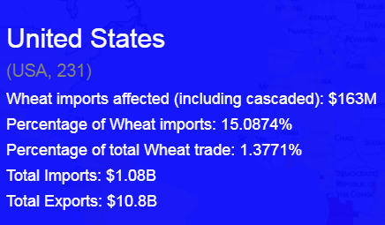
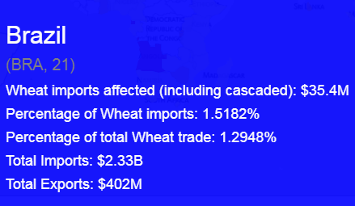
Choropleth Map
GUI & Interactions
Choropleth of 15% wheat reduction from Canada
The United States and Brazil are similarly colored
United States has 15% of its imports affected
Brazil imports are affected by 1.5%
Why are they colored so similar?
Vulnerability is also a function of exports
Notes:
Example here of how exports affect vulnerability
#
As you can see US 15%
Brazil only 1.5%
#
Same color
#

Slide 29
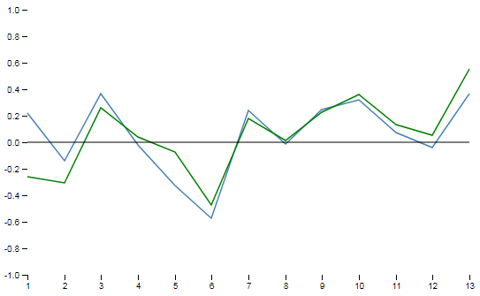
Triad Significance Profile Graphs
Description
TSPs for 2013, Green is corn and
Blue is the four staple crops
Graphs the z-scores of the triad significance profiles
The research in this thesis focused more on cascading impacts to the trade network
Future work will explore the impact of removing network connectors on distributions of triads

Slide 30
Outline
Define the problem
Developed a visual analytics system for exploring second-order effects of climate change under the lens of global trade
Current visualizations
Case studies demonstrating the use of the system
Notes:
We’ll move on to our solution

Slide 31
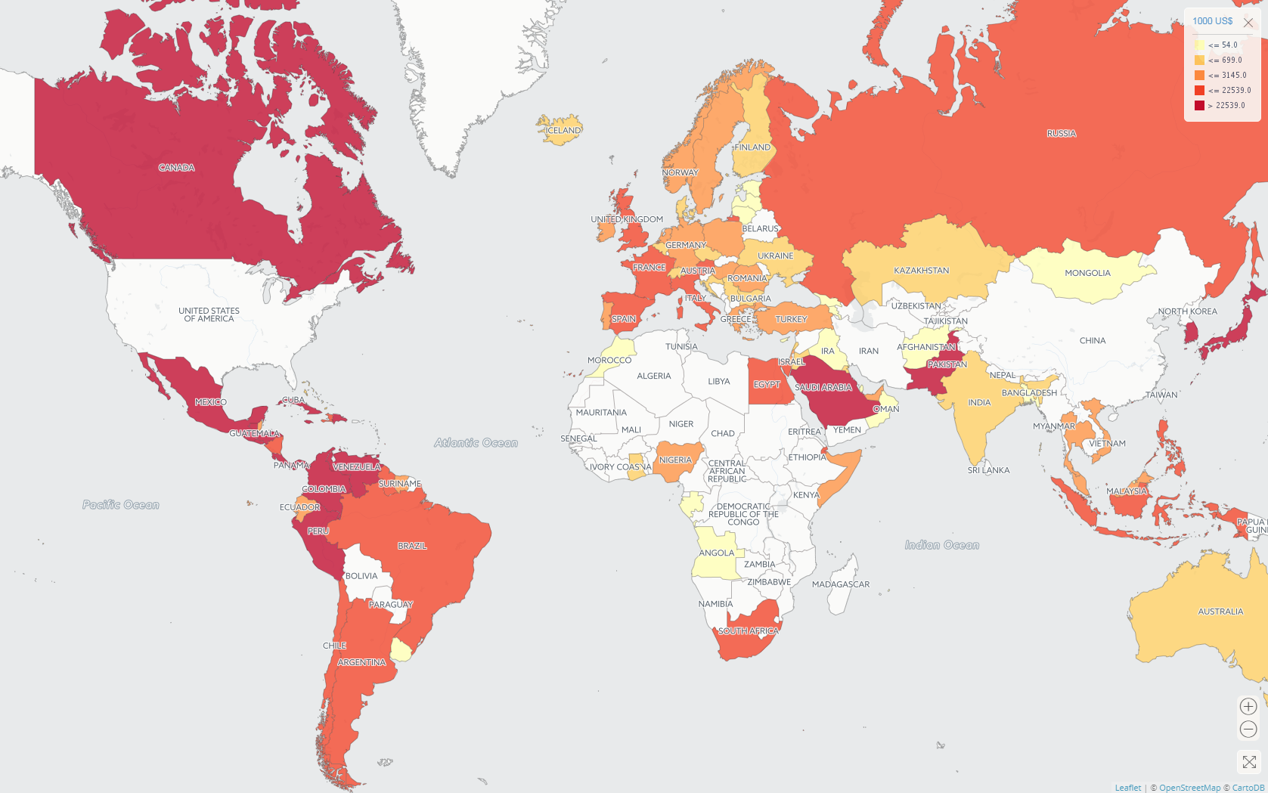
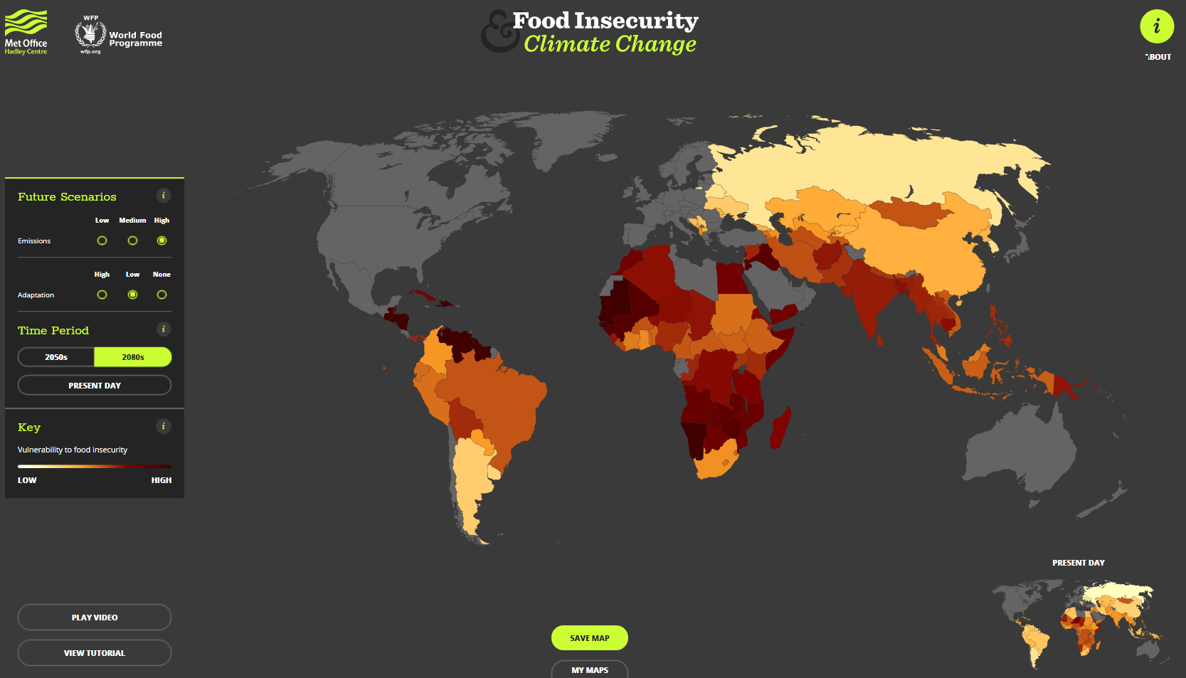
Current Visualizations
Met Office Food Insecurity & Climate Change (www.metoffice.gov.uk/food-insecurity-index)
FAOSTAT Data Visualization
(www.fao.org/faostat/en/#data/TM/visualize)
Notes:
Notice they are both choropleths, it’s hard to visualize a network like this.
Comparisons after the system

Slide 32
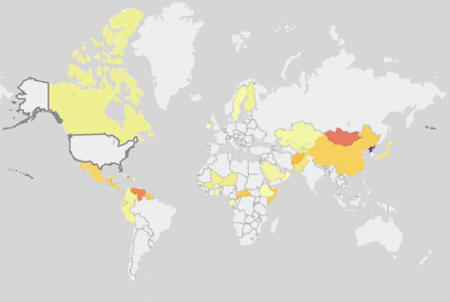
Current Visualizations: Comparisons
Met Office Food Insecurity & Climate Change (www.metoffice.gov.uk/food-insecurity-index)
My System
Notes:
Choropleth makes sense as a representation of vulnerability:
Left: Global scale
Right: Response to climate event

Slide 33
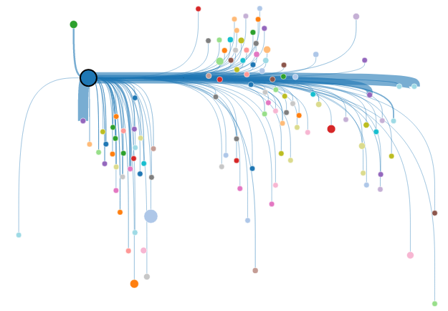
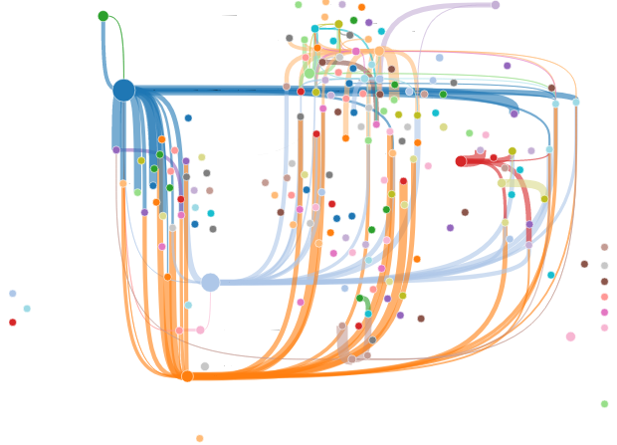
Current Visualizations: Comparisons
FAOSTAT Data Visualization
(www.fao.org/faostat/en/#data/TM/visualize)
My System
Canada
US
From here it looks like Canada and Mexico both import about the same
Mexico
In reality Mexico imported $1.85 billion and Canada $281 million
Notes:
FAOSTAT Viz
Again choropleth, though may not be best representation a trade network
First filtered to show the same information
#
Deceiving visualization
#
We unselected the US, my system allows to visualize the whole network

Slide 34
Current Visualizations: Limitations
The food trade network and food security indices are not modeled together
The food trade network and climate events are not modeled together
No simulation of climate events
How does it affect the trade network
Not a visual analytic system
No knowledge gain
Notes:
Main limitation is the lack of the two being modeled together
No integration of climate events

Slide 35
Outline
Define the problem
Developed a visual analytics system for exploring second-order effects of climate change under the lens of global trade
Current visualizations
Case studies demonstrating the use of the system
Notes:
Introduce my system more

Slide 36
Case Studies
2011 Chinese drought
Simulated US Climate Event

Slide 37
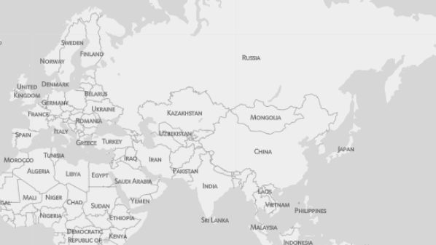
Case Study: 2011 Chinese Drought
A regional climate event potentially had a global effect on food security
The recent Arab Spring has been linked to this regional drought^{[1]}
China doesn’t export wheat to Egypt
How does a drought in China affecting wheat production cause political instability in Egypt?
?
[1] Sternberg, T., “Chinese drought, bread and the Arab Spring”, Applied Geography 34, 519–524 (2012).
Notes:
All the steps
Label all pertinent nodes in the graph
Delete in

Slide 38
Case Study: 2011 Chinese Drought
Food trade network can affected by reduced production or export bans
Large increase in wheat imports to China drives up international prices
Russia continues existing export bans on wheat
From the previous year’s poor harvest due to drought^{[1]}
?
[1] Fellmann, T., S. H´elaine and O. Nekhay, “Harvest failures, temporary export restrictions and global food security: the example of limited grain exports from Russia, Ukraine and Kazakhstan”, Food Security 6, 5, 727–742 (2014).

Slide 39
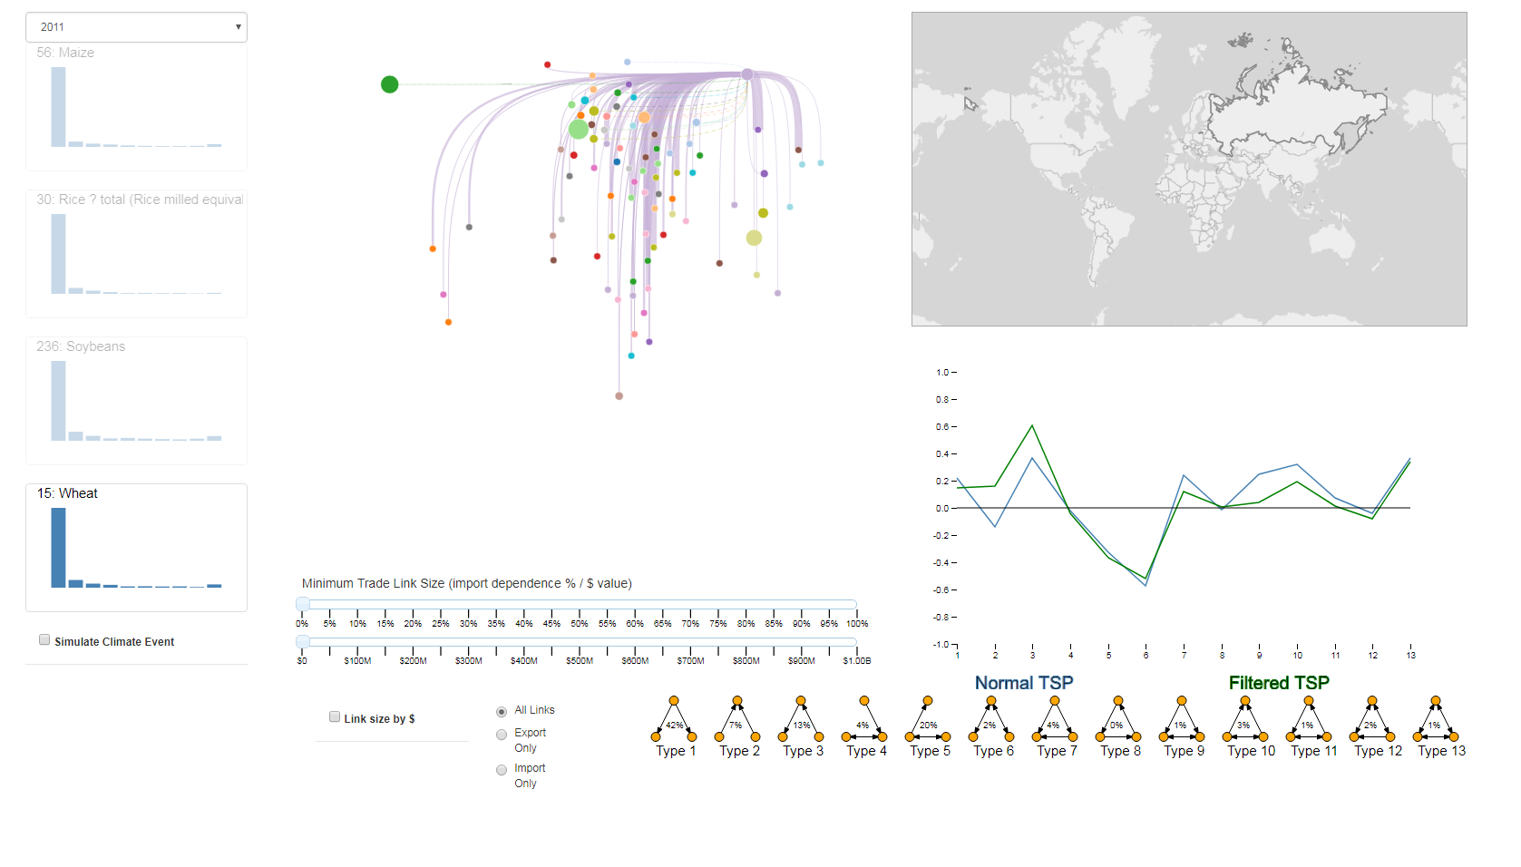
Case Study: 2011 Chinese Drought
Notes:
How can we model that in this system?
In the dashboard we select the year 2011, Wheat, and Russia

Slide 40
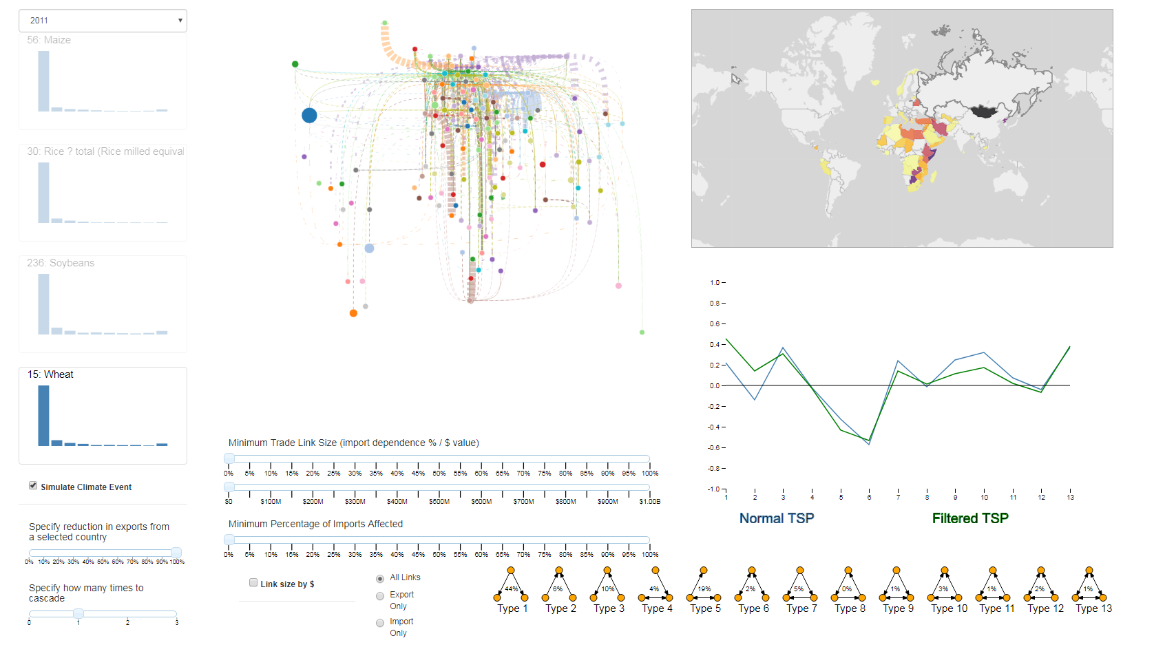
Case Study: 2011 Chinese Drought
Notes:
Check simulate, change % to 100 for the export ban
Visually in the network graph we see lots of broken links
It’s kind of busy at first, but we can start filtering and identify what we want

Slide 41
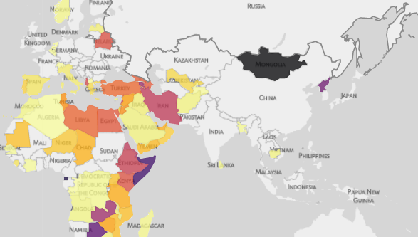
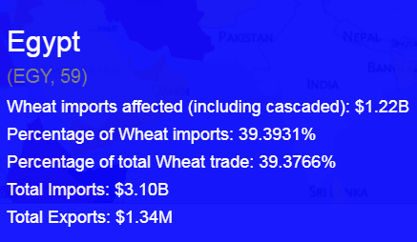
Case Study: 2011 Chinese Drought
Results
Tooltip
Notes:
In this case we want to look at how Egypt would be affected
Zoom in to Egypt on Choropleth
And hovering over the country
This is a good example of an at-risk import dependency link

Slide 42
Case Studies
2011 Chinese drought
Simulated US Climate Event
Notes:
First case study highlighted the vulnerability part,
Second will really show the cascading aspect of system

Slide 43
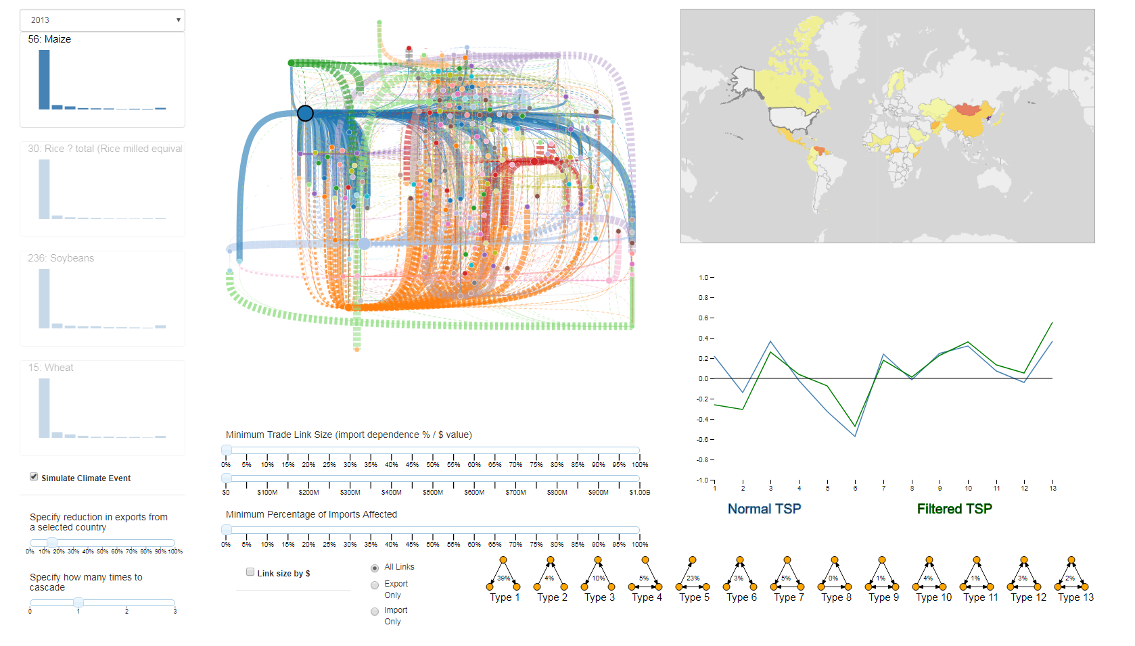
Case Study: Simulated US Climate Event
To highlight cascading effects, we simulate a climate event in the United States
Very busy network graph
Dashed lines are indirect links
Notes:
Again we simulate by selecting the country, crop, year and percent reduction
#
Some initial reactions?
#

Slide 44
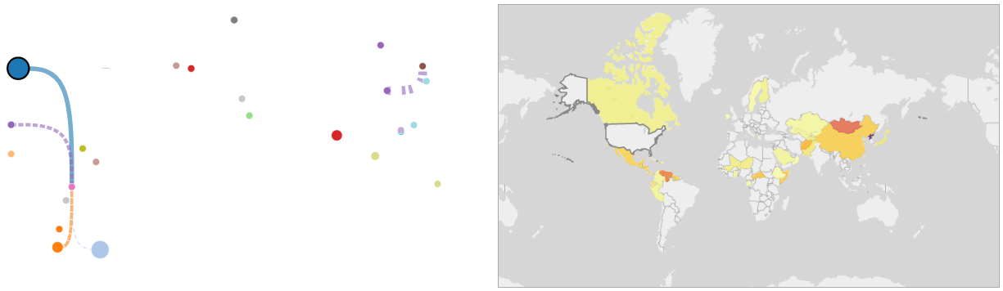
Case Study: Simulated US Climate Event
Add filtering to the network graph
Minimum Trade Link Size ($25 million)
Minimum Percentage of Imports Affected (30%)
Identify two countries of interest: Venezuela and North Korea
Mongolia is red too, but they only import $109k
United States
North Korea
Venezuela
Notes:
To make some sense of this we add filtering to clean out some insignificant links
We have the same choropleth, but now the network graph is a lot cleaner

Slide 45
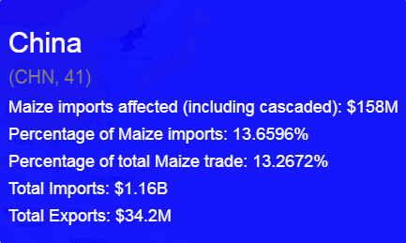
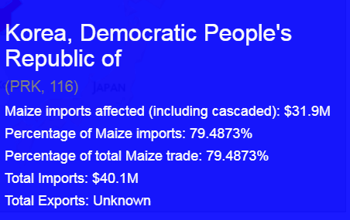
Case Study: Simulated US Climate Event
Results – North Korea:
North Korea has lost ~79% of its corn imports
But North Korea has no direct link from the US
The reduction in imports to China is cascaded to North Korea
Loss of $156 million and only exports $34.2 million
United States
North Korea
Note: There is
No direct trade link!
China
Notes:
We’ll look at the tooltip for North Korea to see how much they were affected
#
Alternating dashes and spaces indicate a broken link
#
China has lost more imports than it exports, mitigate the loss!!!
LIMITATION: This may not be accurate, $34.8 is relatively ? Insignificant would china still import it to north korea knowing the political situation, e.g. wouldn’t be able to get it anywhere else

Slide 46
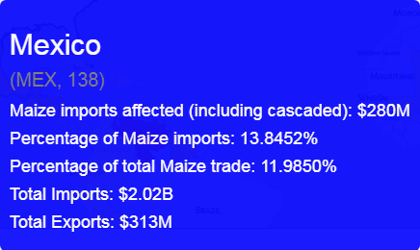
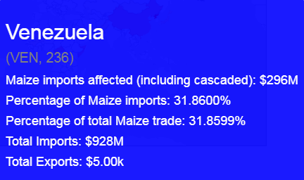
Case Study: Simulated US Climate Event
Results – Venezuela:
Venezuela has lost ~32% of its corn imports from a 15% US export reduction
Loss of $296 million in imports, but the direct trade link is only $55 million
The reduction in imports to Mexico is cascaded to Mexico
Note: US to Venezuela trade link is only $55 million
Notes:
Venezuela has lost ~32% of its corn imports from a 15% US export reduction
#
Not a first order affect because it can not be accounted for only with direct reduction because the trade link is only $55 million
#
Almost all of Mexico’s imports are lost, we assume they would stop exporting to mitigate the loss, remember that we had filtered on links of > $25 million

Slide 47
Conclusion
Future work
Explore triad changes to network
Dynamic calculation of triads
Vulnerability index could be affected by other factors
Adaptability
Political climate
Different crop value measures
Virtual water
Cropland area
Efficacy of visual analytic system
User surveys
Best visual choices?
Questions?

Slide 48
Edge crossing
Understand it was important
Purchase, H., “Which aesthetic has the greatest effect on human understanding?”, in “International Symposium on Graph Drawing”, pp. 248–261 (Springer, 1997).
Reviewed
Dunne, C. and B. Shneiderman, “Motif simplification: improving network visualization readability with fan, connector, and clique glyphs”, in “Proceedings of the SIGCHI Conference on Human Factors in Computing Systems”, pp. 3247–3256 (ACM, 2013).
Holten, D. and J. J. Van Wijk, “Force-directed edge bundling for graph visualization”, in “Computer graphics forum”, vol. 28, pp. 983–990 (Wiley Online Library, 2009).
Nodetrix^{[1]} is undirected
Felt it was important to keep countries separate, grouping them could skew vulnerability
i.e. Saudi ($769m import of wheat 2013) and Qatar ($36m import of wheat 2013) right next to each other
Mental mapping
We are familiar with where countries are located
Lots of filtering and interactions (dragging network graph) available to minimize
[1] Henry, Nathalie, Jean-Daniel Fekete, and Michael J. McGuffin. "NodeTrix: a hybrid visualization of social networks." IEEE transactions on visualization and computer graphics 13.6 (2007): 1302-1309.

Slide 49
Triads
Cascaded or second-order effects
Triad types 3, 4 & 7 account for around 20% of triads, indicating this paradigm exists
Triad distributions for four staple crops in the year 2013
Z-score calculations were based on the triad distribution of 1 random graph type
200 nodes
1800 edges
Notes:
As TSP not a focus, I didn’t want to impede GUI with time consuming random graph creation and triad counting
Limitation was the random graphs

Slide 50
Visual Analytics
Analytical reasoning facilitated by interactive visual interfaces
Cook, K. A. and J. J. Thomas, “Illuminating the path: The research and development agenda for visual analytics”, (2005).
Analyze first, show the important, zoom/filter/analyze further and details on demand
Keim, D. A., F. Mansmann, J. Schneidewind and H. Ziegler, “Challenges in visual data analysis”, in “Information Visualization, 2006. IV 2006. Tenth International Conference on”, pp. 9–16 (IEEE, 2006).
Notes:
Analyzed a simulation, filter to zoom, tooltips for details

